Slide 1

SYSTEMS ANALYSIS AND DESIGN CIS 5200-01 Ecommerce Behavior Data from Multi Category Store
Project – 2
Lekha AjitKumar
Sushmitha Dandu
Dauren Omarov
Navyasree Sriramoju

Slide 2
INDEX
Data Specification
Introduction
Flow Chart
Agenda
H/W Specification

Slide 3

DATA SPECIFICATION
Data Size : 15.83 GB
Data Source URL: https://www.kaggle.com/datasets/mkechinov/ecommerce-behavior-data-from-multi-category-store?select=2019-Oct.csv
Dataset Rows:
Dataset Column: 10
GitHub Link:

Slide 4
H/W EXPERIMENTAL SPECIFICATIONS
Cluster Version | Hadoop 3.1.2
Cluster Number of Nodes | 3 Nodes
Memory Size | 390.7 GB
CPU Speed | 1995.309 MHz
Number of Core CPU | 4

Slide 5
INTRODUCTION
This dataset contains customer behavior data for October and November 2019. The size of the dataset is 5GB. There are 10 columns in this set, which are, as follows: time, type, product id, category id, category code, brand, price, user id, and user session.
In this data set our goal is to analyze customer buying behavior. We have Data from 2 different months, hence we also compare the buying and viewing patterns of customers. We have chosen this dataset because it will help companies understand requirements of the users and help maximize their sales and production of demanding goods.

Slide 6
FLOWCHART OF DATA ANALYSIS
Download Dataset from Kaggle
Upload Dataset to HDFS
Created Table in Beeline
Analysis of Data using Visualization, Bar and Pie chart in Tableau
Data
Cleaning
Export Results

Slide 7
Workflow Chart
Buying
Patterns
Stored in Company’s Database
Customers
Offered to us in Kaggle
Downloaded Dataset to System
Data
cleaning
Creating Tables
Writing Queries
Saving Files to Local System
Performing Visualization
Analysis

Slide 8
AGENDAS
Top 10 Least popular categories in October and November
Sum of Sales in both October and November
Top 10 purchased categories in October and their sales count and average price.
Top 5 hours with most purchases in November

Slide 9
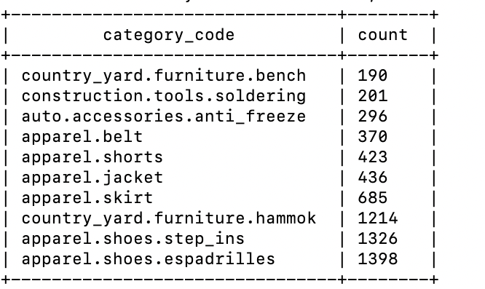
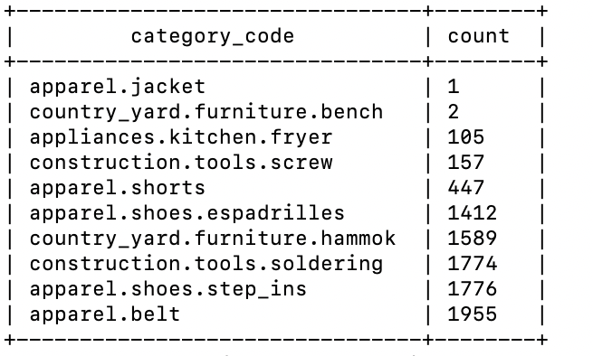
AGENDA-1
Top 10 Least popular categories in October and November
October
select category_code, count(category_code) as count from cleanedoctober group by category_code order by count(category_code) limit 10;
November
select category_code, count(category_code) as count from cleanednovember group by category_code order by count(category_code) limit 10;

Slide 10
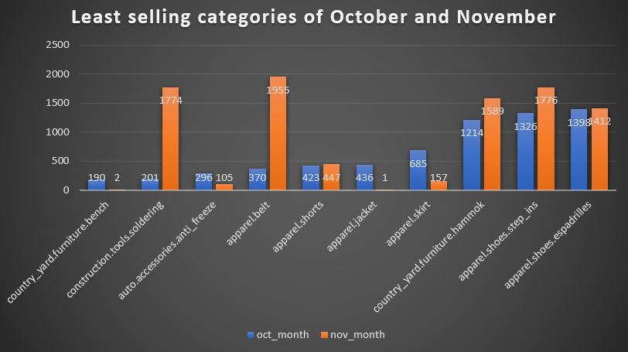
Bar Graph
Top 10 Least popular categories in October and November

Slide 11
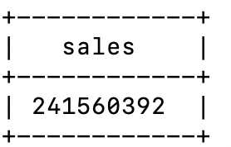
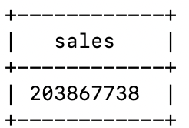
AGENDA-2
Sum of Sales in both October and November
October
select cast(sum(price) as bigint) as sales from cleanedoctober where event_type like 'purchase’;
November
select cast(sum(price) as bigint) as sales from cleanednovember where event_type like 'purchase';

Slide 12
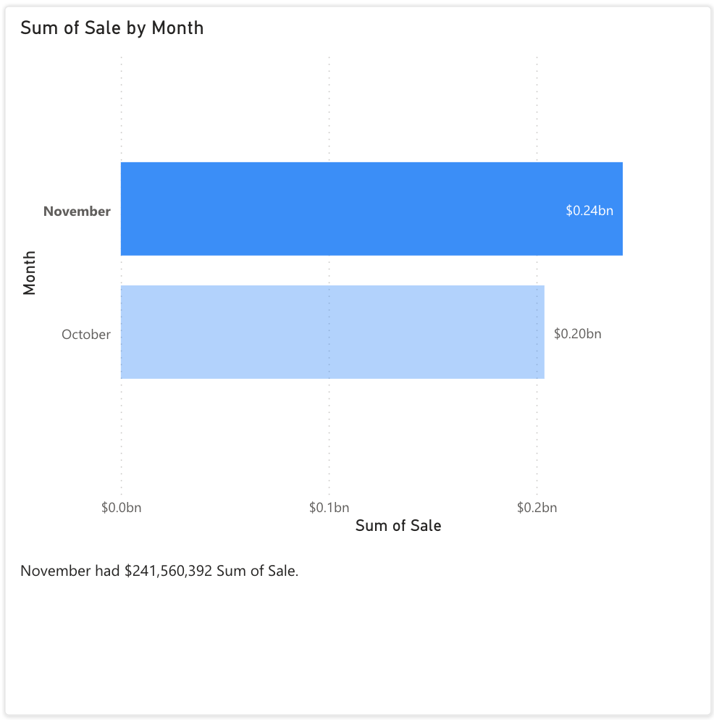
Sum of Sales in October and November

Slide 13
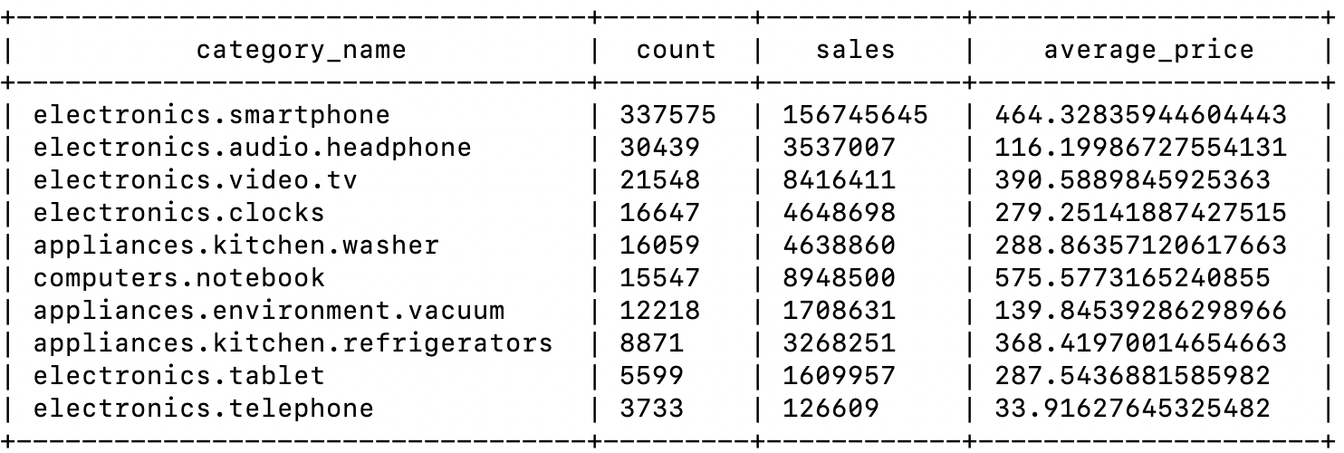
Agenda -3
Top 10 purchased categories in October and their sales count and average price.
select category_code as category_name, count(category_code) as count, cast(sum(price) as bigint) as sales, avg(price) as average_price from cleanedoctober where event_type like 'purchase' group by category_code order by count(category_code) desc limit 10;

Slide 14
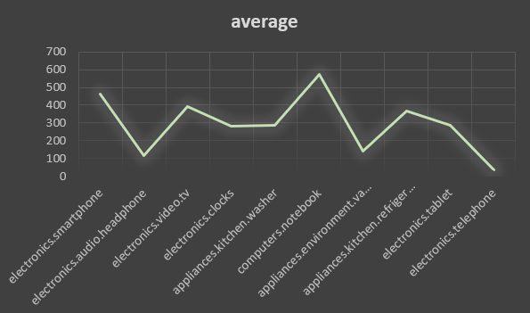
Top 10 purchased categories in October and their sales count and average price

Slide 15
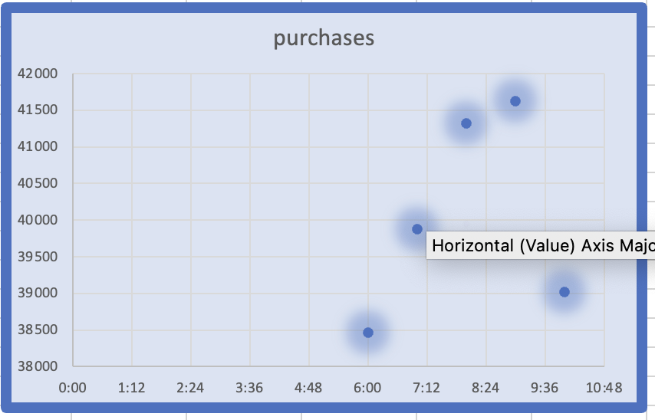
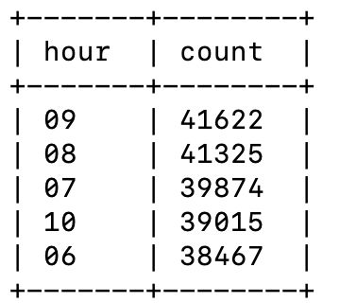
Agenda -4 Top 5 hours with most purchases in November
Select substr(event_time, 12, 2) as hour, count(substr(event_time, 12, 2)) as count from cleanednovember where event_type like 'purchase' group by substr(event_time, 12, 2) order by count(substr(event_time, 12, 2)) desc limit 5;

Slide 16
Conclusion
From all the above work we can conclude the following:
Furniture Bench and Jackets are the least purchased categories in October and November, respectively.
Sales in November are more than Sales in October.
Smartphones are the most purchased Category in October.
Most of the purchases happened around 9’o clock.

Slide 17

THANK YOU

